Slide 1










Data Science Bootcamp
Project 2 – Part 3
Fraud Transaction Classification
Marwa Salah

Slide 2
Project Description
In this project we were initially tasked with selecting a couple of datasets for analysis that meet the following rules:
  Available to use
  Suitable for use in a professional environment
  Does not contain any personal information
  Not used for any assignment, lecture or task from this environment
My Proposed Sets: Credit Card Transaction Data & Financial Sales Data. Former was approved.
So far, the project covers the following progress:
  Dataset selected
  Data Cleaning Done
  Initial Exploratory Data Analysis Completed
Using Modified Dojo Slides Presentation Template

Slide 3







Data Description
Anonymized credit card transactions labeled as fraudulent or genuine
Transformed using PCA
Contains transactions made by European credit card holders in Sep 2013
2 Features were not transformed using PCA which are Time & Amount
Data source is kaggle.
Data Shape is:
  28 Components, 2 Features & 1 Label
  284807 Rows (Observations)
Data Types:
All features are Integers of type int64
Due to nature classes are highly unbalanced.
Classification Target:
Feature 'Class' is the response variable, and it takes value 1 in case of fraud and 0 otherwise.
ML Problem Type is:
Classification
Using Modified Dojo Slides Presentation Template
Notes:
Feature 'Time' contains the seconds elapsed between each transaction and the first transaction in the dataset.

Slide 4
Data Cleaning
Due to PCA preprocessing Data Cleaning needed was very limited.
No Nulls found
No Data Type Inconcistencies
No Categorical Inconsistencies would exist
A Number of Duplicates were there (~1000 rows) which were dropped
Using Modified Dojo Slides Presentation Template

Slide 5

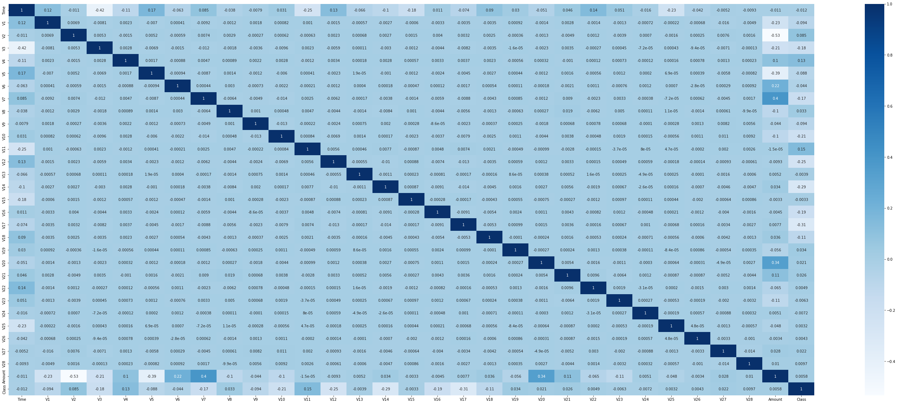
Visuals
Using Modified Dojo Slides Presentation Template

Slide 6
Challenges
Due to PCA transformation, couldn’t make sense of data or get deeper understanding of features, their correlations or meaning and relevance to output or label
The same reason above made it difficult to generate more meaningful exploratory visualizations.
PCA was still unknown to me at the time we were required to complete this part of the project.
Using Modified Dojo Slides Presentation Template

Slide 7
Next Steps
Use Credit Card Fraud Detection Simulator @ https://fraud-detection-handbook.github.io/fraud-detection-handbook/Chapter_3_GettingStarted/SimulatedDataset.html for testing the model once created
The feature 'Amount' is the transaction Amount, this feature can be used for example-dependant cost-sensitive learning, explore this if time allows and apply it in the project if its relevant
Using Modified Dojo Slides Presentation Template

